Slide 1
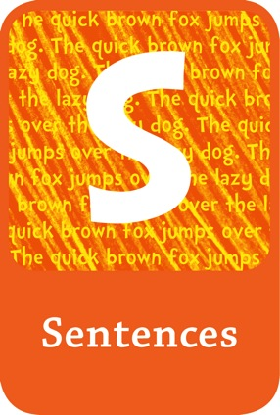
Adding conjunctions to sentences to build complex sentences
Page 79

Slide 2
Compound and complex sentences
Sentence
conjunction
sentence.
Conjunctions are words that join ideas (think about the word ‘junction’).

Slide 3
Page 76
Examples of coordinating conjunctions – these do not make complex sentences and they usually only go in the middle of a sentence.
and
but
or
so
Conjunctions
Some common conjunctions which build complex sentences (subordinating conjunctions)
before
since
as
so that
where
although
when
because
while
as though
until
after

Slide 5
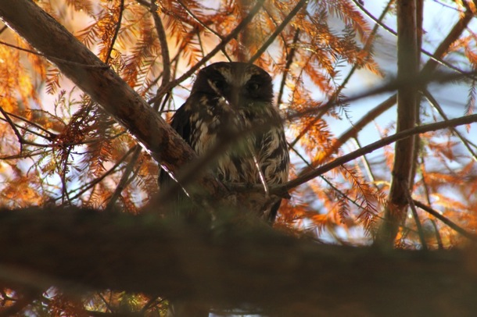
I do
The owl peered through the branches.

Slide 6
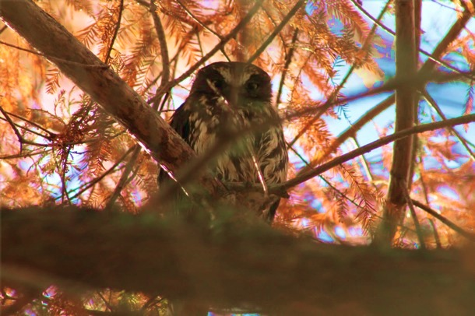
I do
The owl peered through the branches while he searched for prey.
I can add a conjunction and tell you more about what the owl was doing.

Slide 7
Page 76
Examples of coordinating conjunctions – these do not make complex sentences and they usually only go in the middle of a sentence.
and
but
or
so
Conjunctions
Some common conjunctions which build complex sentences (subordinating conjunctions)
before
since
as
so that
where
although
when
because
while
as though
until
after

Slide 8
I do
while
The owl peered through the branches
The owl peered through the branches while he searched for prey.
he searched for prey.
Think, pair, share:
Can you find ‘sentence’ ‘conjunction’ ‘sentence’?

Slide 9
We do
The owl sat motionless on the branch.
Can you and your partner add a conjunction and tell us more about the owl?
where
although
when
because
while
after
Conjunctions
before
since
as
so that
As though
until

Slide 10
Self-check
Sentence
conjunction
sentence.

Slide 11
We do
The baby owls waited patiently in the nest.
Can you and your partner add a conjunction and tell us more about the owl?
where
although
when
because
while
after
Conjunctions
before
since
as
so that
as though
until

Slide 12
Self-check:
Check your sentence makes sense
Check your punctuation A.
Partner-check:
Read your sentence to another pair
Find the conjunction
Tell your partner what new information you learned from the new sentence (clause)

Slide 14
Next steps
Conjunction
sentence
sentence.
,
While
the owl sat on the branch
she devoured a cricket.
,

